Slide 1

SAP BTP ABAP on Cloud / RAP Training
DAY-07
Anubhav Oberoy
www.AnubhavTrainings.com
Follow excellence with sheer passion

Slide 2


DISCLAIMER
The training content and delivery of this presentation is confidential, and cannot be recorded, or copied and distributed to any third party, without the written consent of Anubhav Trainings

Slide 3

01
Virtual Elements
02
Business App Studio
03
Fiori App in BAS
04
Approver Scenario
Notes:
https://pixabay.com/photos/san-francisco-transamerica-pyramid-1633203/

Slide 4

Development Flow – Processor and Approver
Fiori App – Processor
Create, update, delete, copy travel
Fiori App – Approver
Display the travel request data
Service definition
Service Binding
Service definition
Service Binding
MDE for Processor Projection
MDE for approver Projection
BDEF Projection
For Processor
Expose what is needed by a processor role in company
Behavior Definition (BDEF)
Tell RAP framework regarding our operations which needs to be supported for BO (managed)
BDEF Projection
For Approver
Expose what is needed by a approver role in company
Business Object Projection
For Processor
30 fields to internet
Business Object (definition)
Includes the Travel, Booking and Booking Supplement CDS entities
100 fields
Business Object Projection
For Approver
25 fields
www.anubhavtrainings.com

Slide 5
Virtual Elements
There is a requirement to expose extra elements out of cds entities for which there is no data inside the database, basically these element values are calculated at runtime (on-fly). If you worked with SAP UI5 development, we have similar concept called formatter. We have a implementing class in which we will add our code for calculating the runtime data of virtual elements.
Rules:
We should only add them to projection view. Because if you add in main view, your draft table will disturb and your main table will never have these column.
RAP does not support filtering and sorting of virtual elements, also the aggregation and group is not allowed
We cannot select data from virtual elements using direct SELECT or EML
We have to write implementation in a class for virtual element that class must use the interface IF_SADL_EXIT_CALC_ELEMENT_READ.
www.anubhavtrainings.com

Slide 6
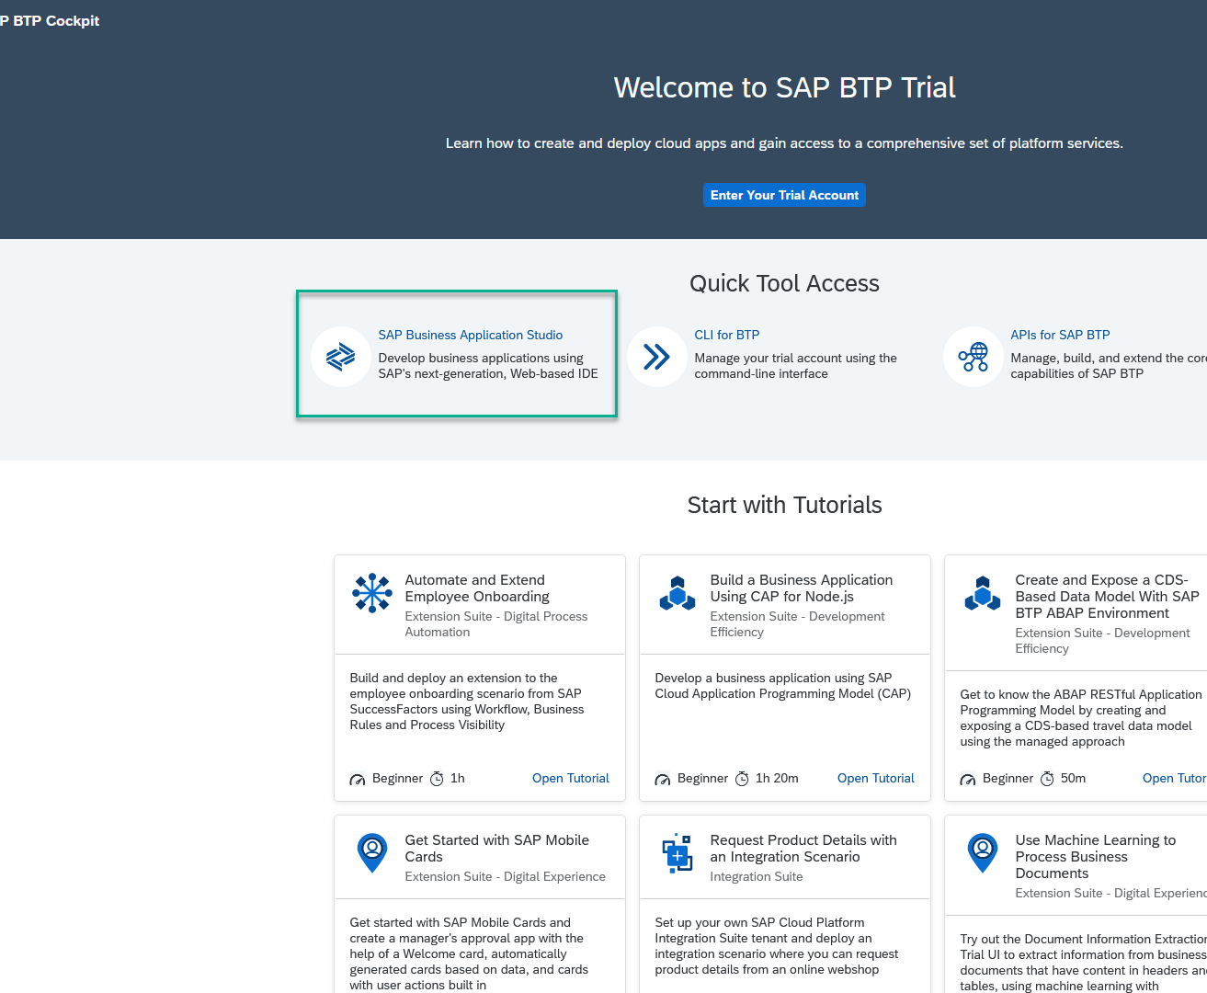
Business Application Studio
SAP Business Application Studio is a development environment available on SAP Business Technology Platform. It is a multi cloud development environment to create different kinds of Apps like HANA Native, CAPM, Fiori, MDK etc. A developer must create private dev space in the system in order to build application in BAS tool, All the required tooling is pre-configured in BAS.
In an Enterprise Account you can set up SAP Business Application Studio as a Free-Tier service by checking its free plan during its entitlement configuration.

Slide 7
Dev Space in BAS
We don’t want a single developer to consume all the available resources
We want a clear isolation of one developer with another
Pre-configured by sap for specific development
Solution - Virtualize
Dev Space
Dev Space
Dev Space
SAP BAS – Business App Studio
SAP BTP – Platform as a Service
IaaS – Infrastructure as a Service

Slide 8

Approver
Scenario

Slide 9
www.anubhavtrainings.com
Thank You
End of Day 07
www.anubhavtrainings.com

Slide 10


We’re committed to empower you to be
#FutureReady
through powerful training solutions.
We build the workforce of the future.
250+
Corporate Clients
30,000+
Learners Trained
25000+
Learners Placed
FREE WEBINARS
Sign up for free webinars with industry experts every fortnight!
Enroll Now!
Contact us today!
https://anubhavtrainings.com

